Slide 1
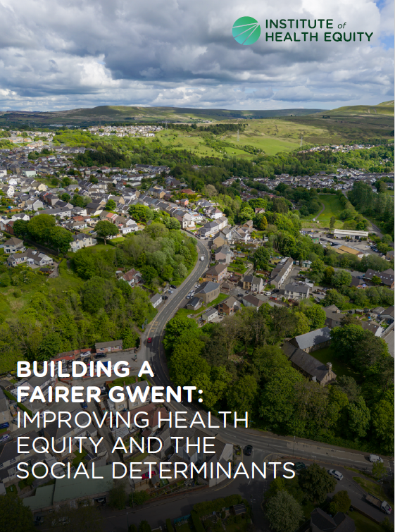
Building a Fairer Gwent
July 2023

Slide 2
Report
Recommendations
Marmot Gwent Indicators
Executive summary
Datapacks
www.instituteofhealthequity.org

Slide 3
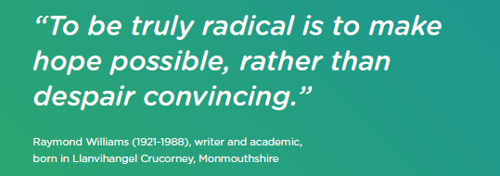

Slide 4
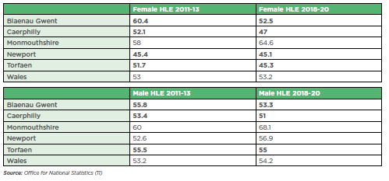
Evidence: Female and male healthy life expectancy at birth in the most deprived areas, Gwent local authorities and Wales, 2011-13 and 2018-20

Slide 5
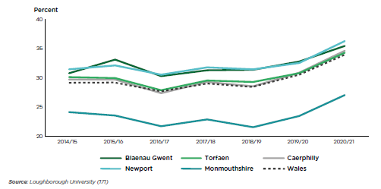
Evidence: Percent of children in poverty, after housing costs, Gwent local authorities and Wales, 2014/15-2020/21

Slide 6
Evidence: Most recent official take-up estimates for different benefits

Slide 7
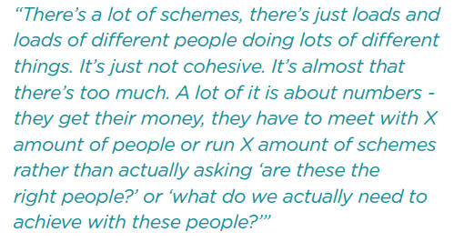
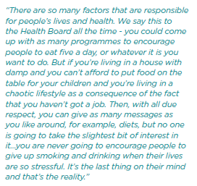
Evidence: Your words

Slide 8
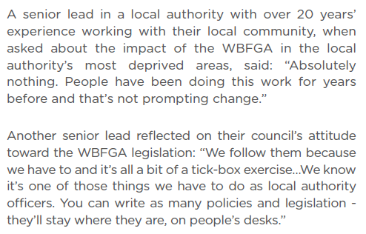
Policy analysis: Wellbeing of Future Generations (Wales) Act 2015

Slide 9
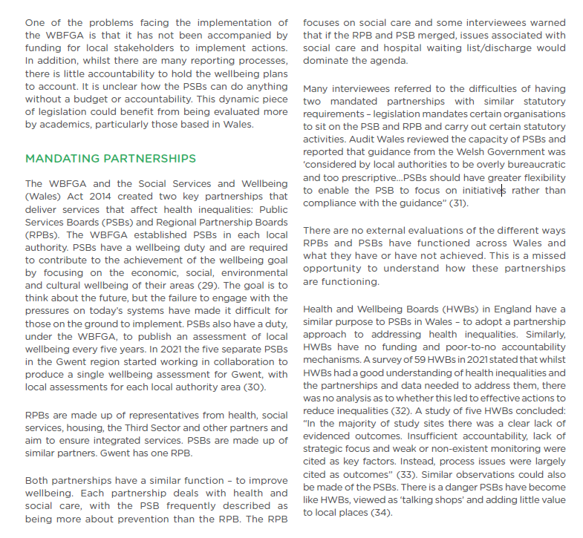
Mandating Partnerships

Slide 10
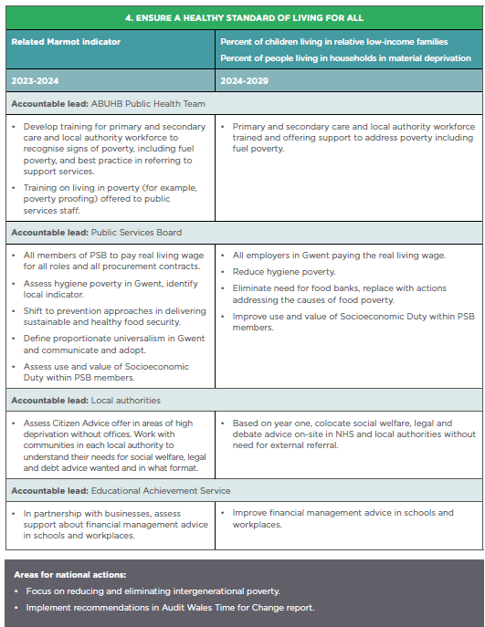
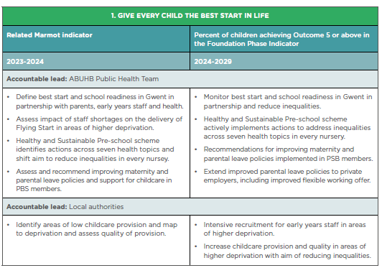

Slide 11
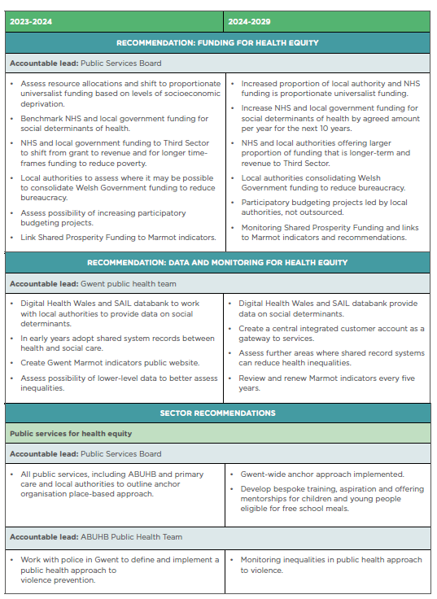
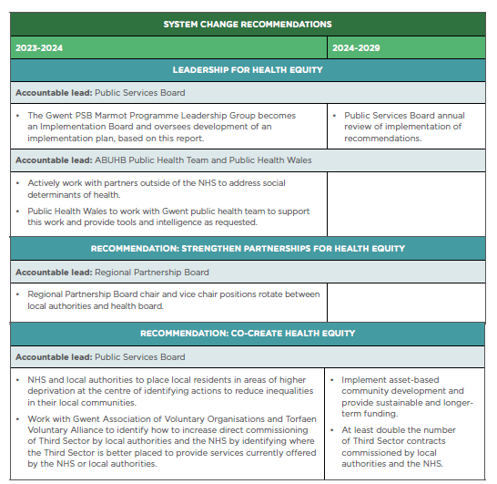

Slide 12
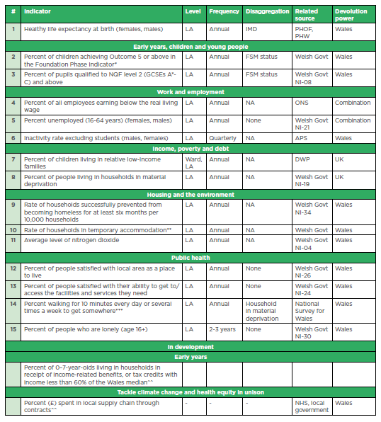
Marmot Gwent indicators

Slide 13
Diolch yn fawr

